Slide 1
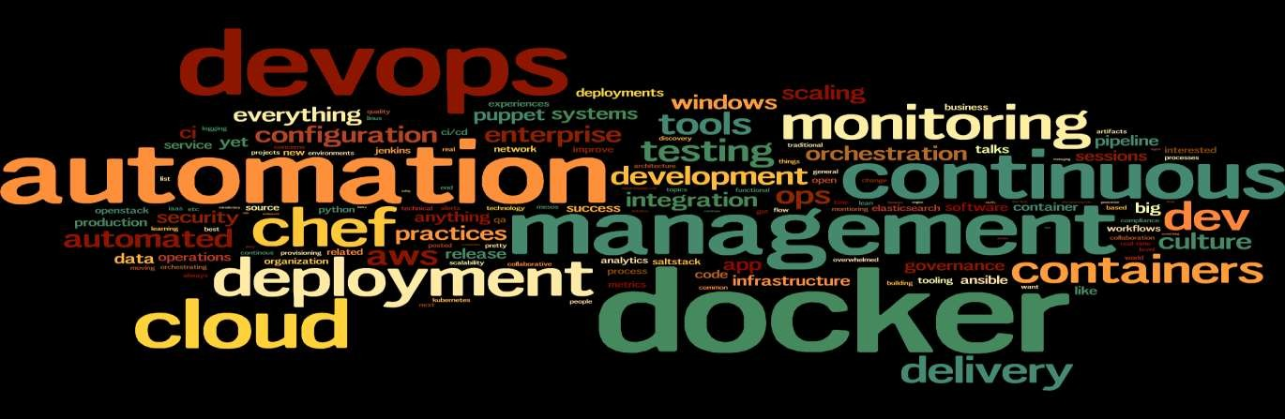
Sujata Batra
Introduction to DevOps

Slide 2

Sujata Batra

Slide 3
What is DevOps?
Sujata Batra

Slide 4
What is DevOps?
Sujata Batra
“It’s a movement of people who think its time for change in the IT industry – time to stop wasting money, time to start delivering great software and building systems that scale and last” – Patrick Debois

Slide 5
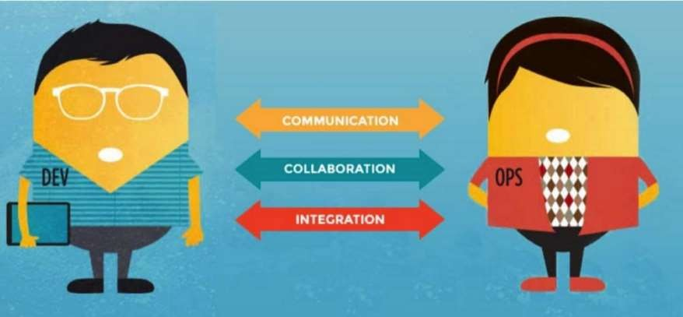
DevOps Philosophy
Sujata Batra

Slide 6

Sujata Batra

Slide 7
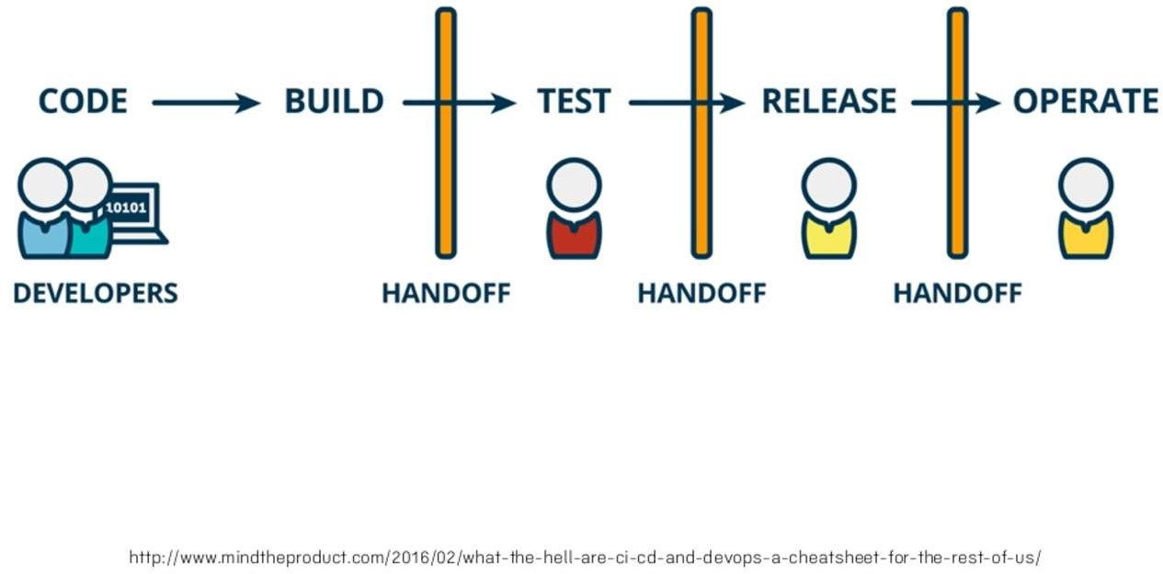
Sujata Batra

Slide 8
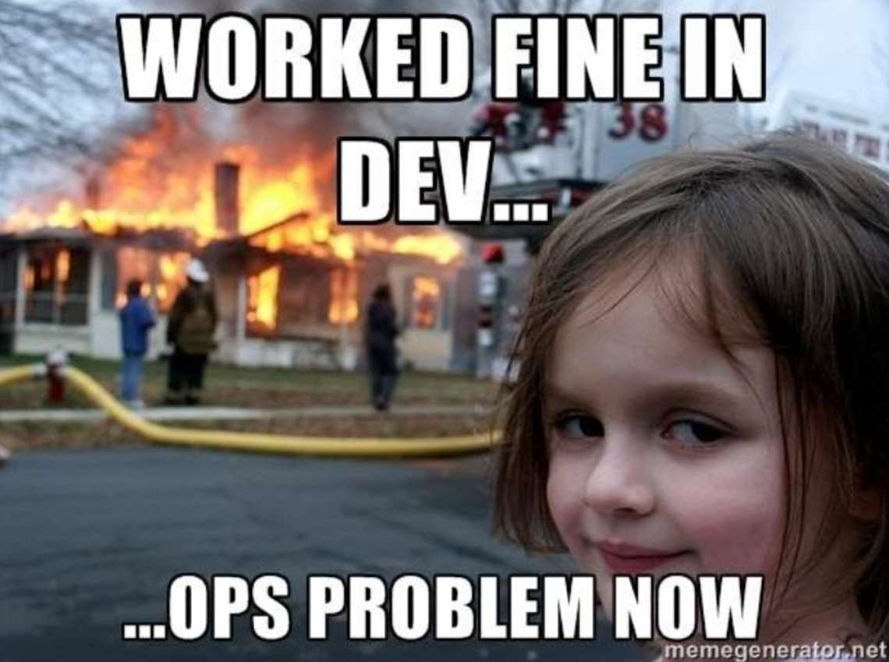
Sujata Batra

Slide 9
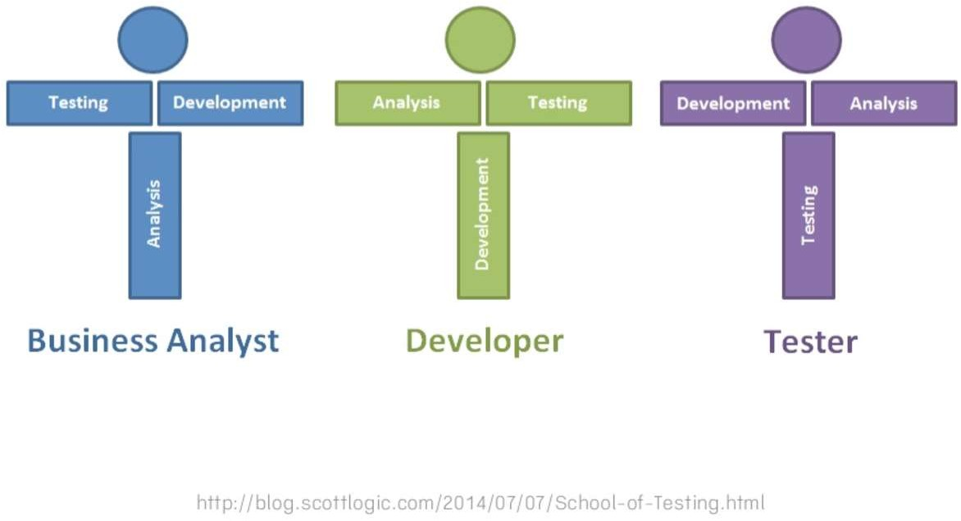
Sujata Batra

Slide 10

Sujata Batra

Slide 11

Sujata Batra

Slide 12










Sujata Batra
Patrick Debois 2008
Cameron Haight
2011
2009
2013
2015+
John Allpaw
Paul Hammond
Gene Kim

Slide 13
Why DevOps?
Sujata Batra

Slide 14
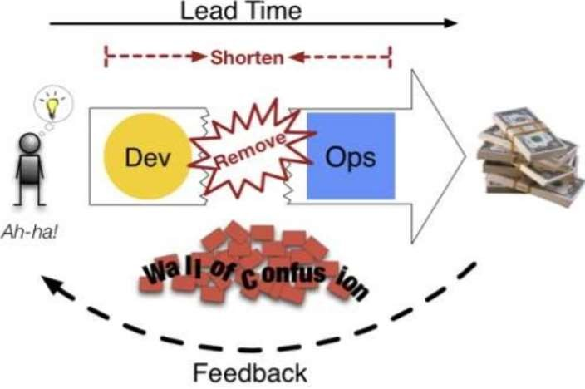
Sujata Batra

Slide 15
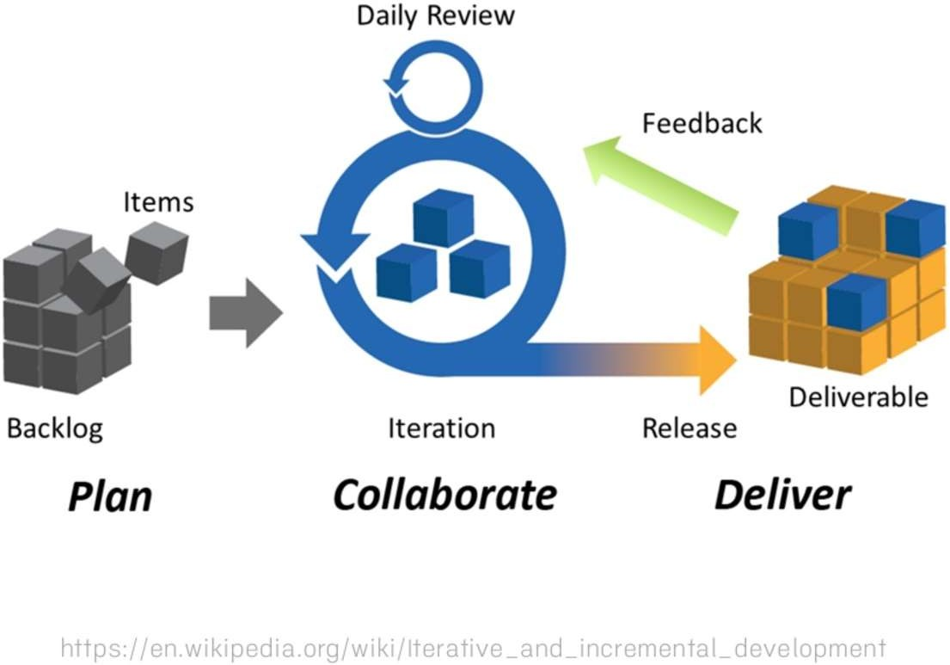
Sujata Batra

Slide 16
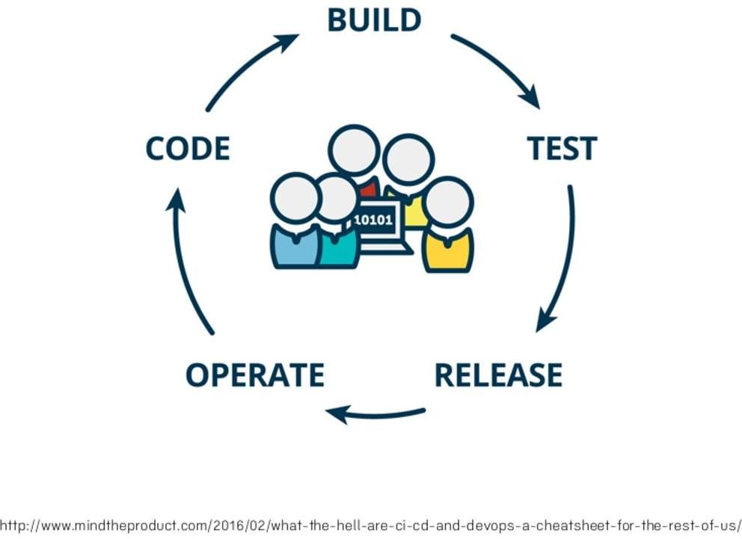
Sujata Batra

Slide 17
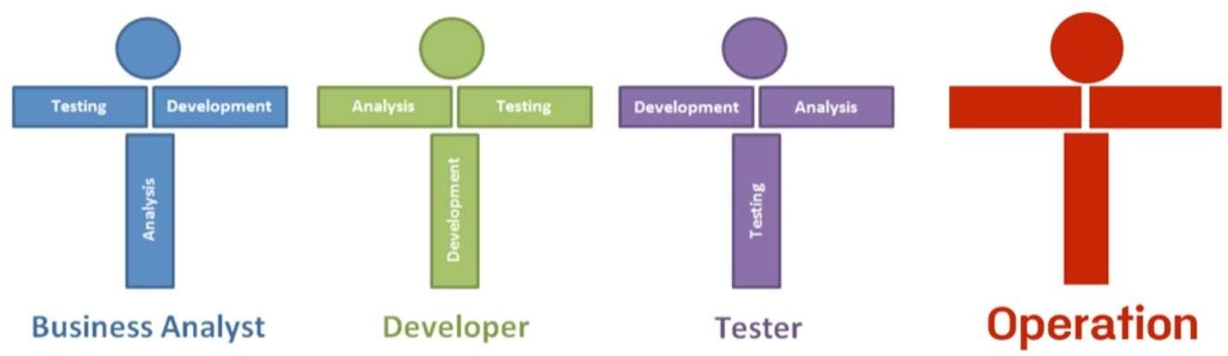
Sujata Batra

Slide 18
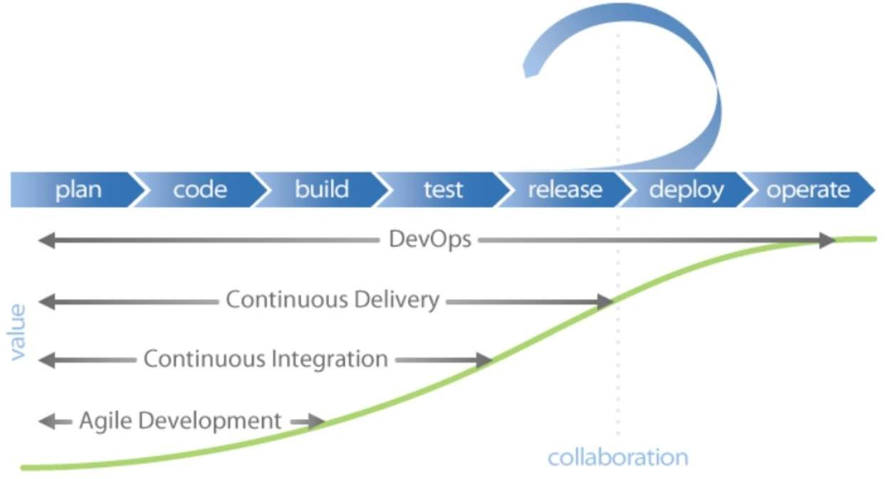
Why does it Matter?
Sujata Batra

Slide 19

Sujata Batra

Slide 20
How to start DevOps?
Sujata Batra

Slide 21
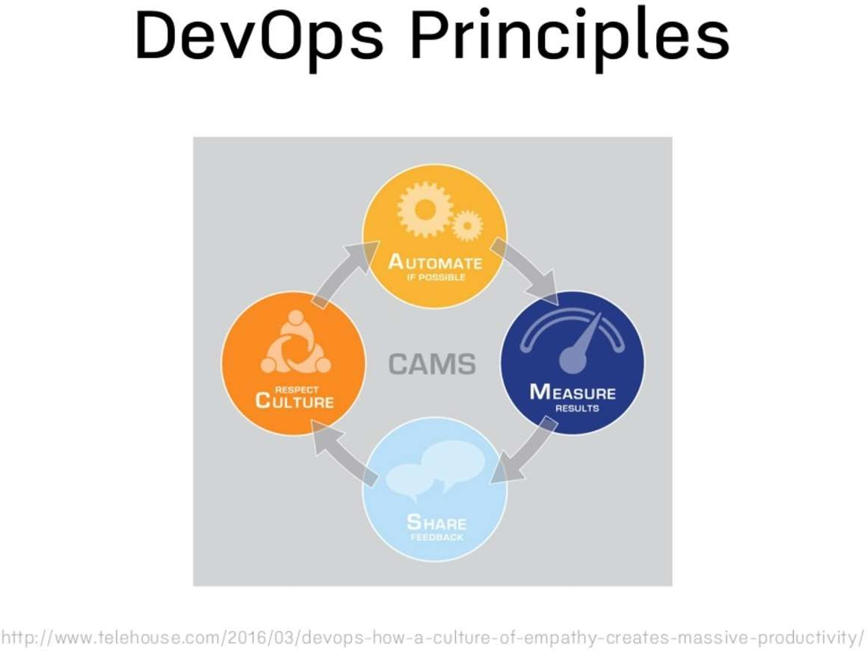
Sujata Batra

Slide 22
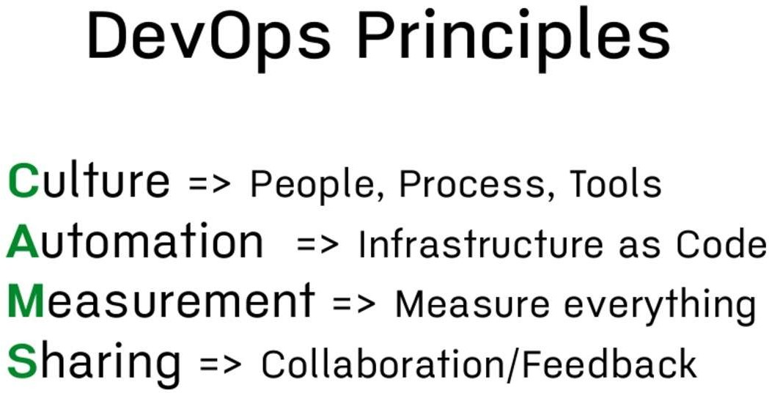
Sujata Batra

Slide 23
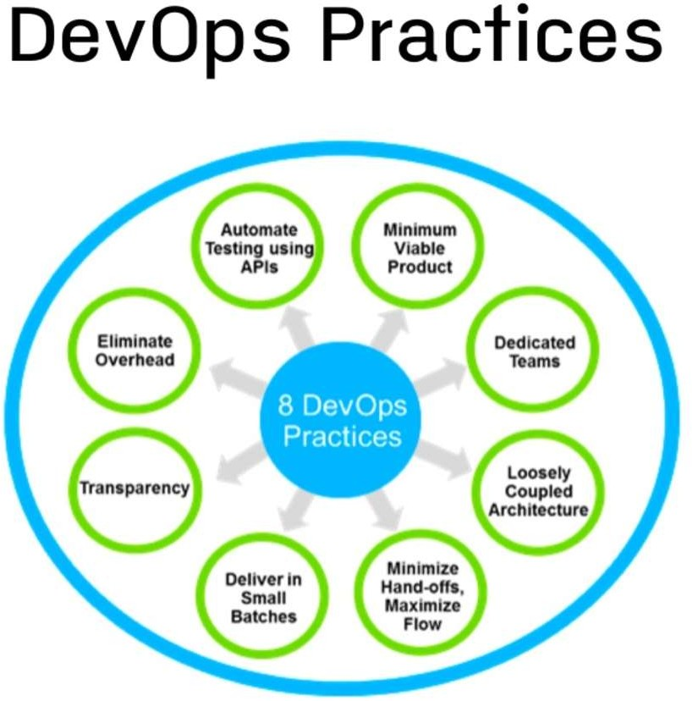
Sujata Batra

Slide 24
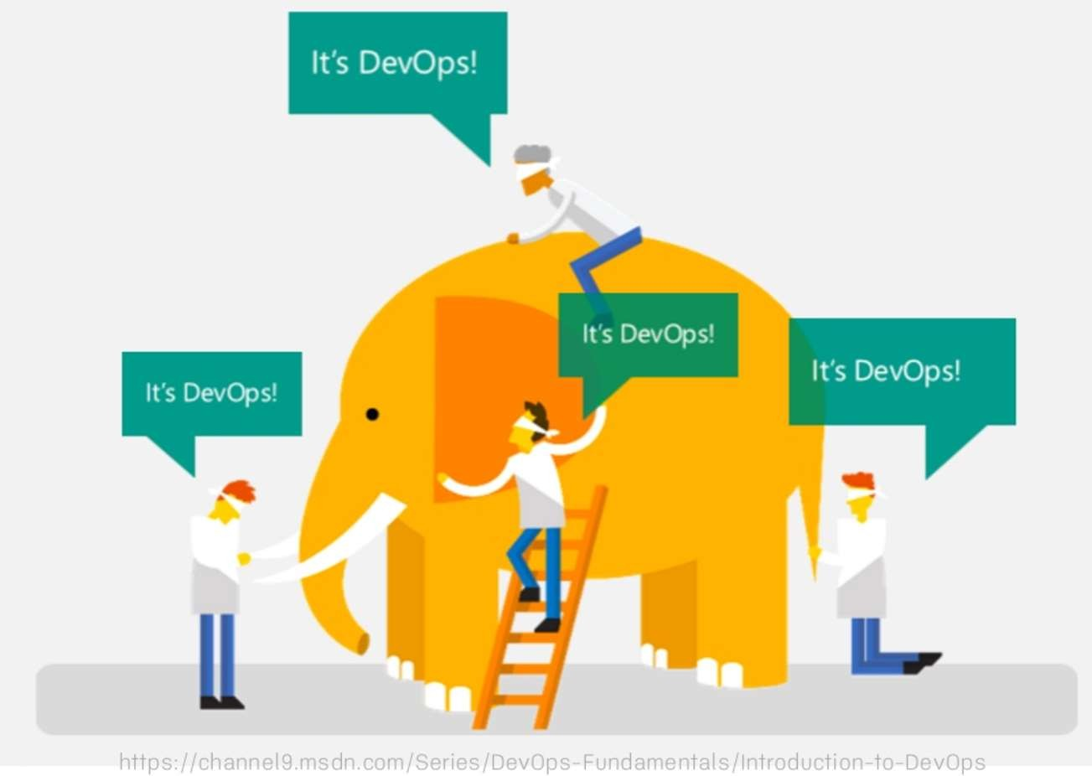
Sujata Batra

Slide 25
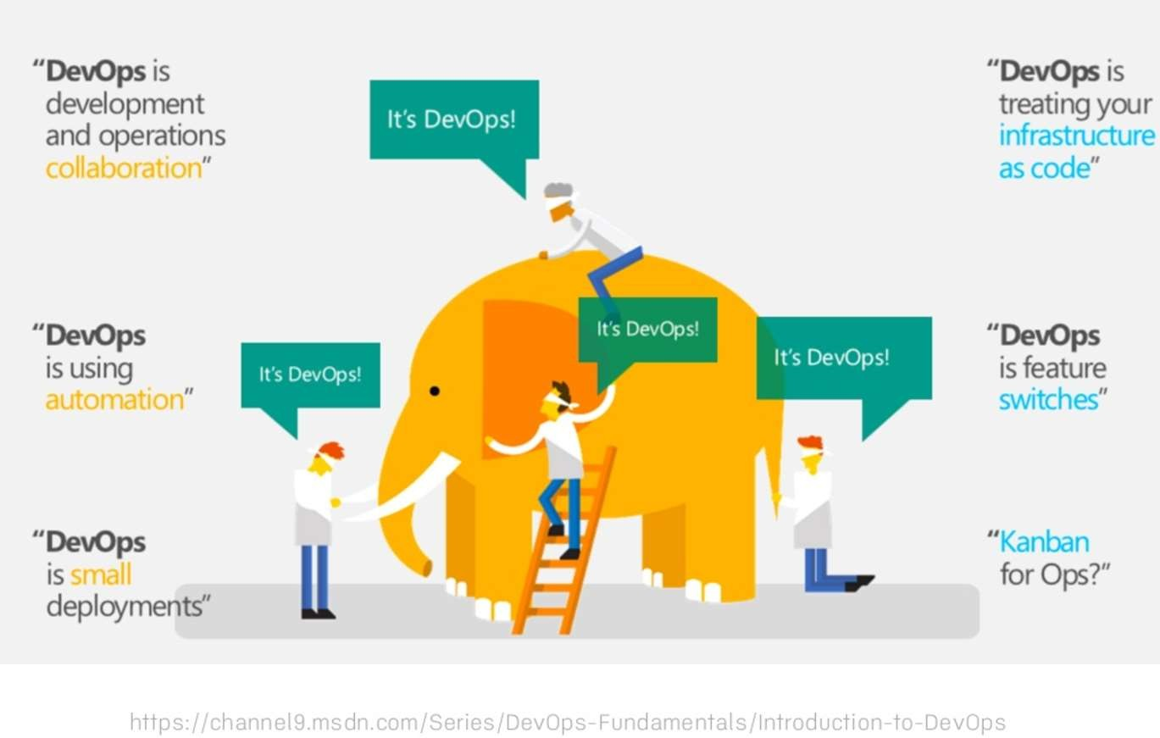
Sujata Batra

Slide 26
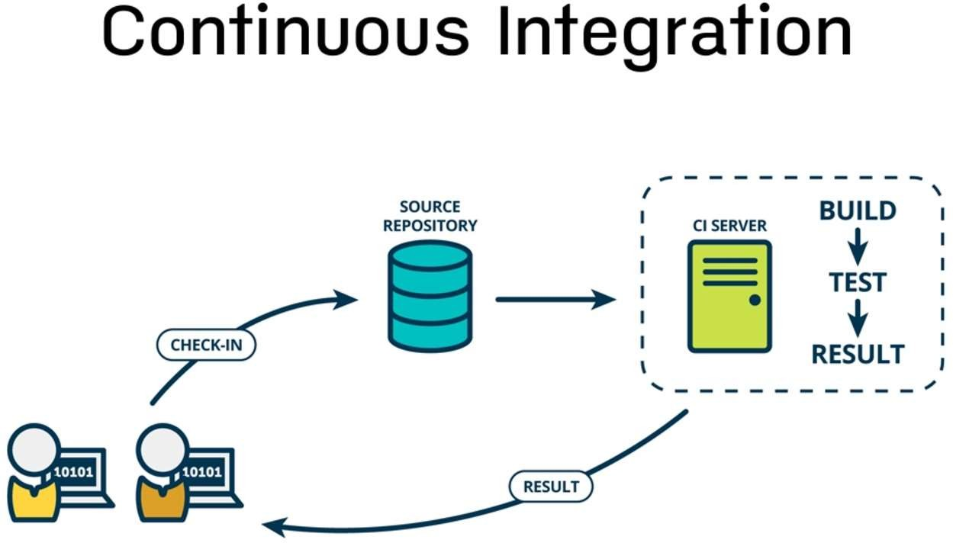
Sujata Batra

Slide 27
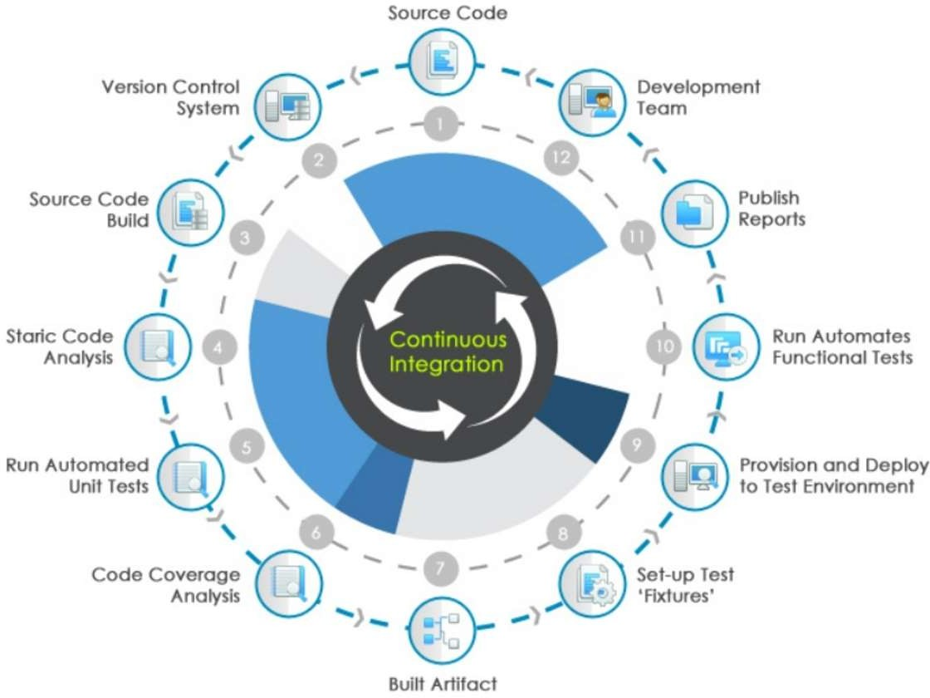
Sujata Batra

Slide 28
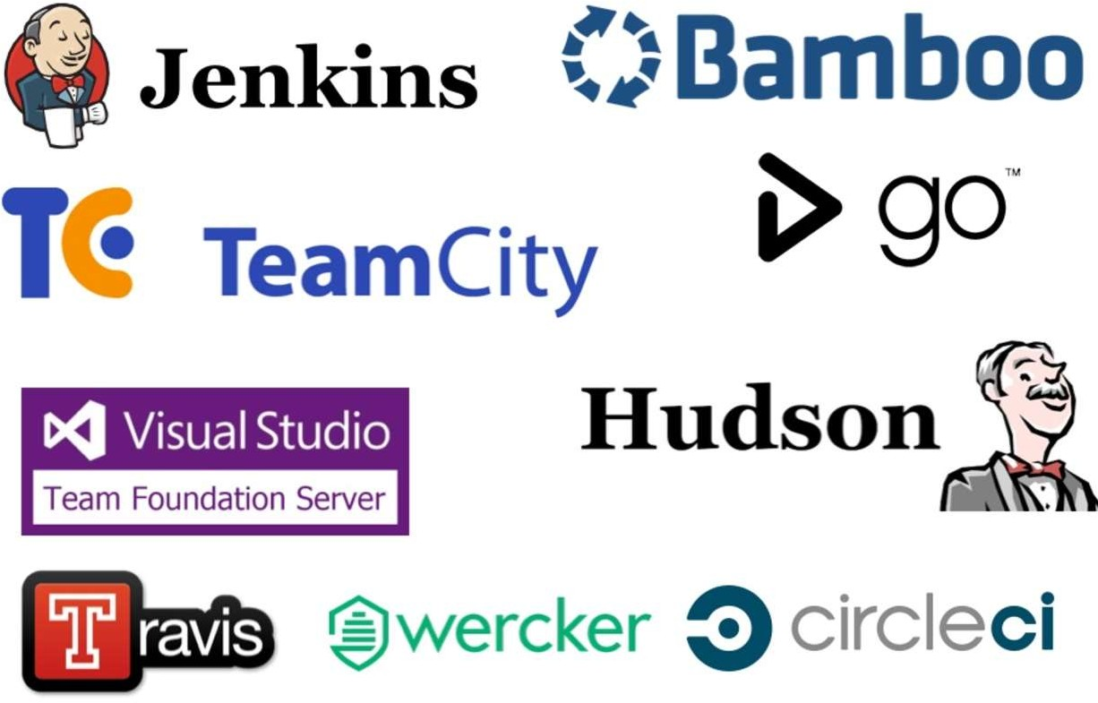
Sujata Batra

Slide 29
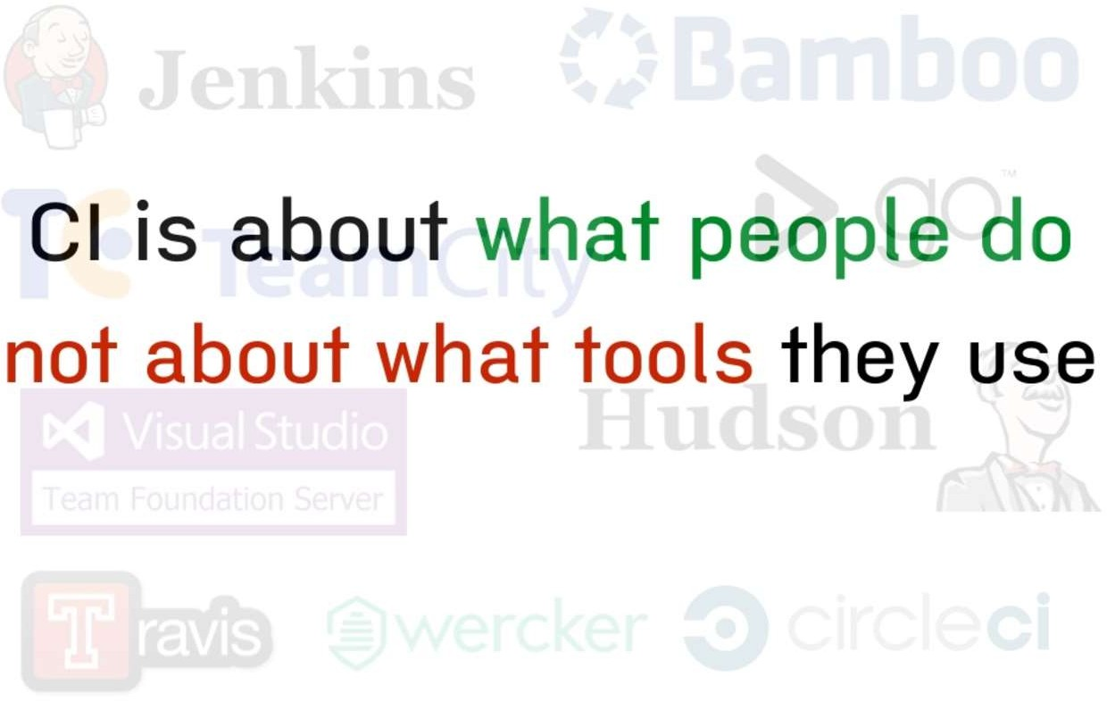
Sujata Batra

Slide 30
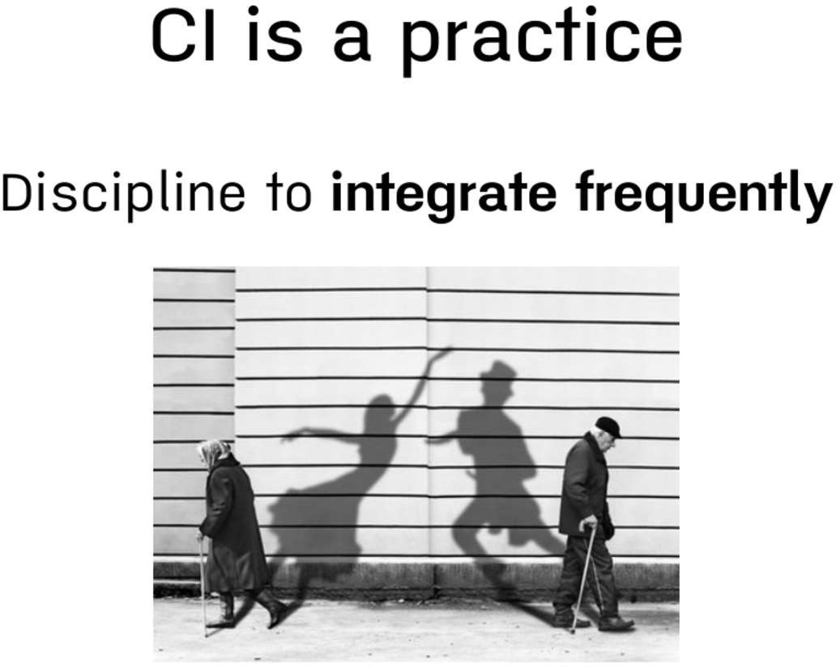
Sujata Batra

Slide 31
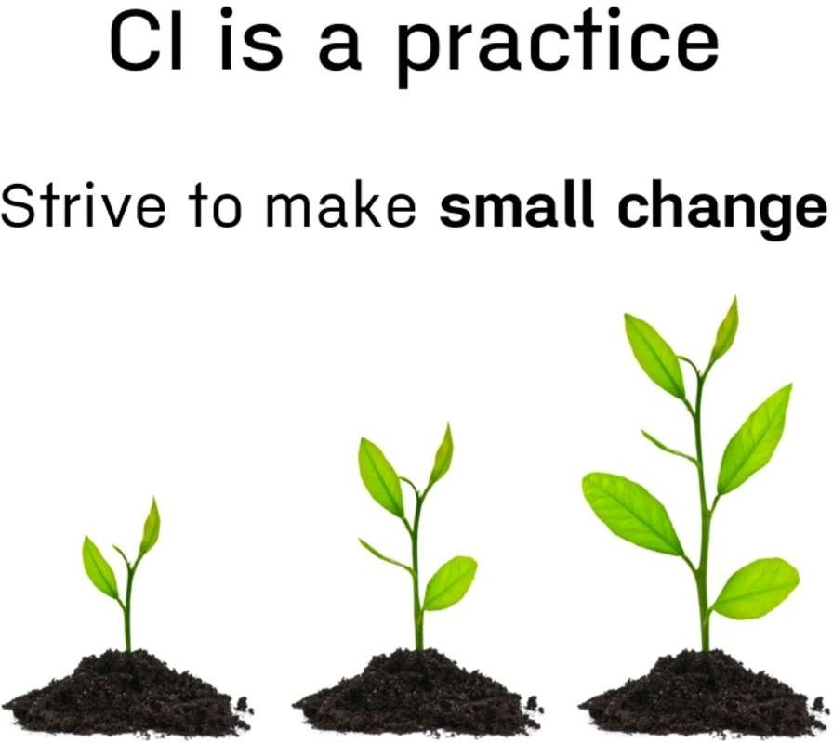
Sujata Batra

Slide 32
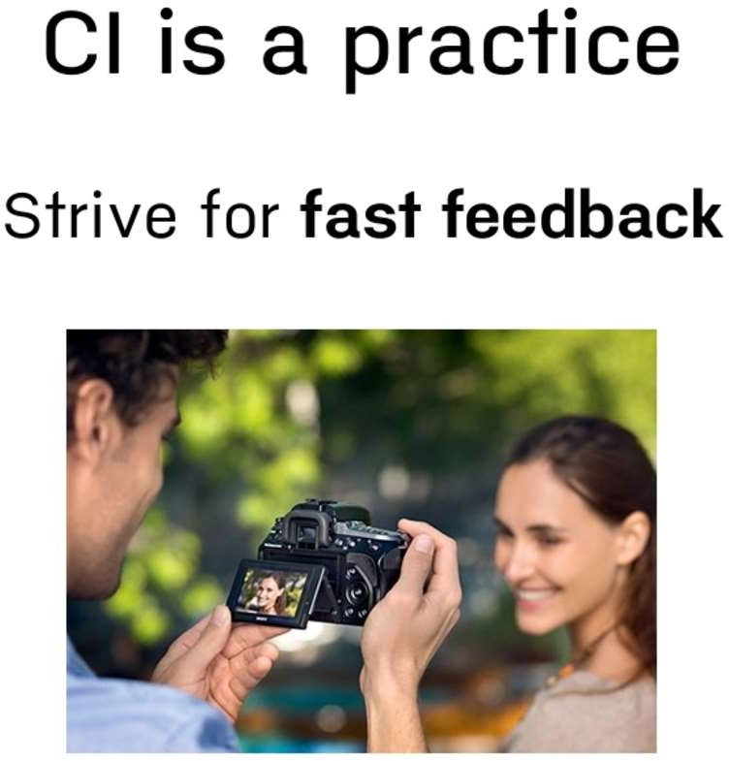
Sujata Batra

Slide 33
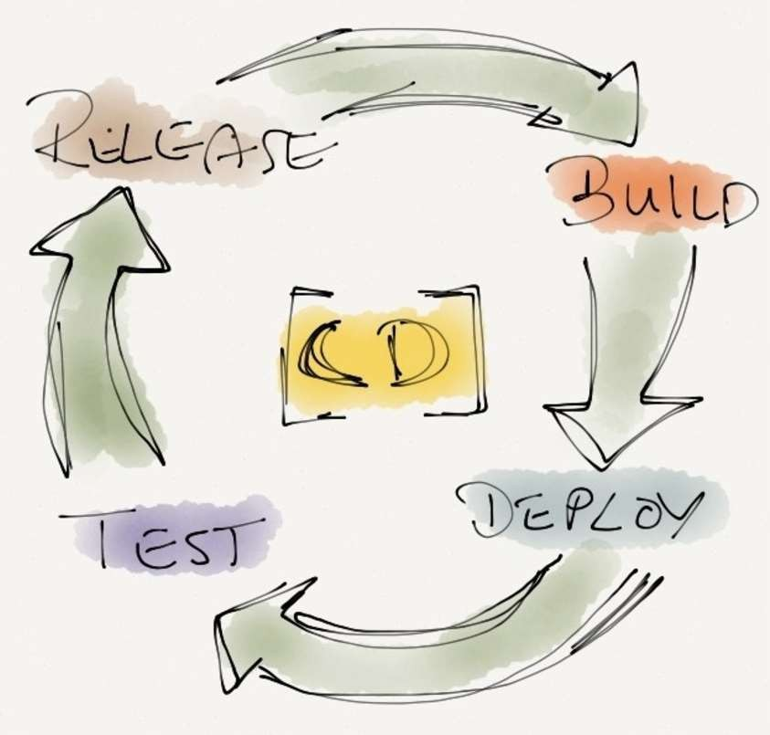
Sujata Batra

Slide 34
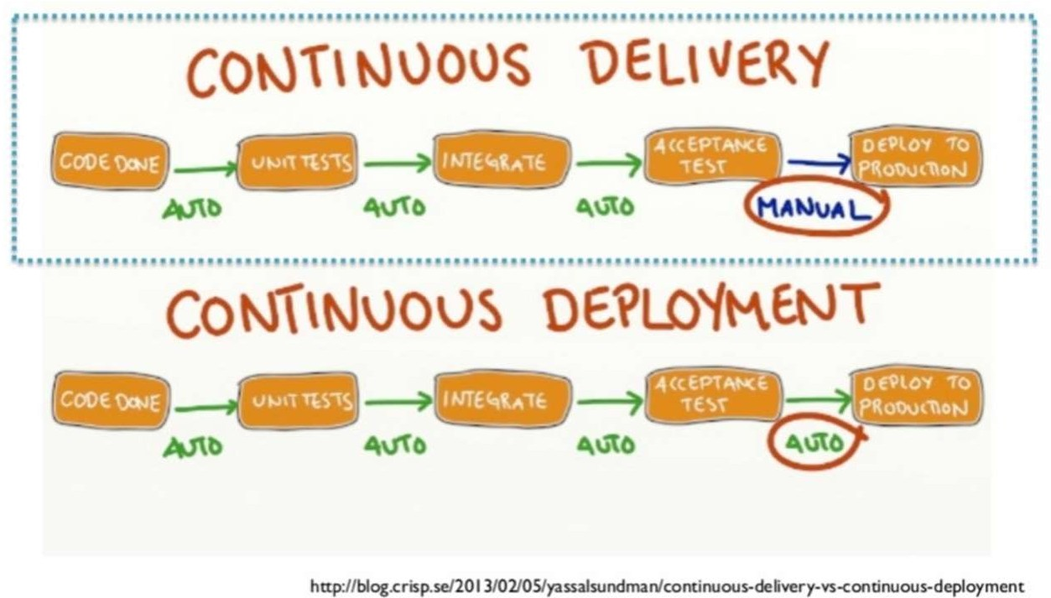
Sujata Batra

Slide 35
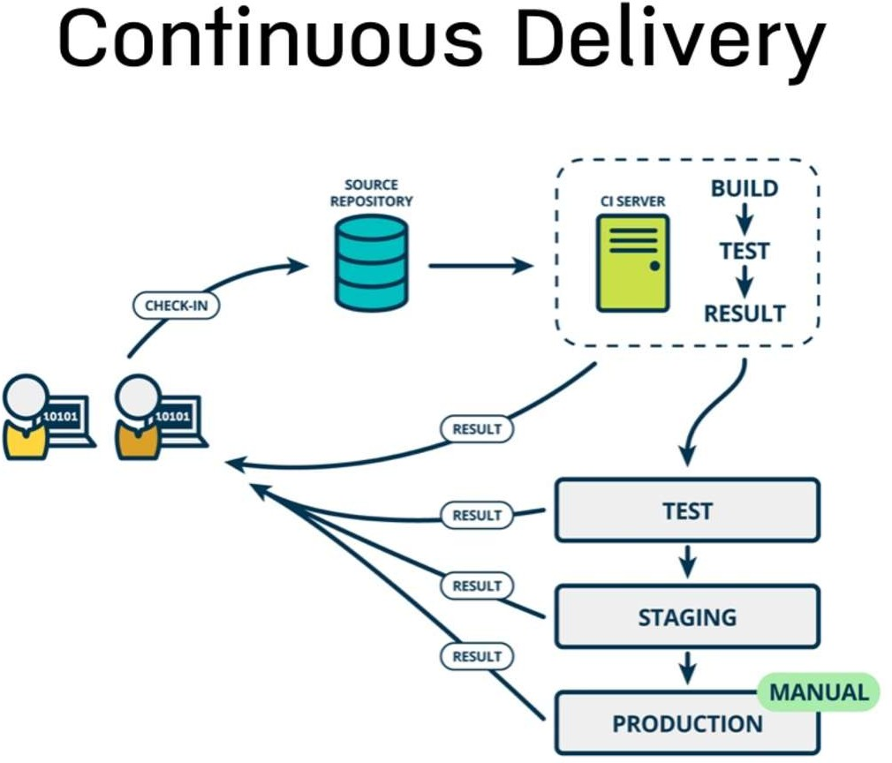
Sujata Batra

Slide 36
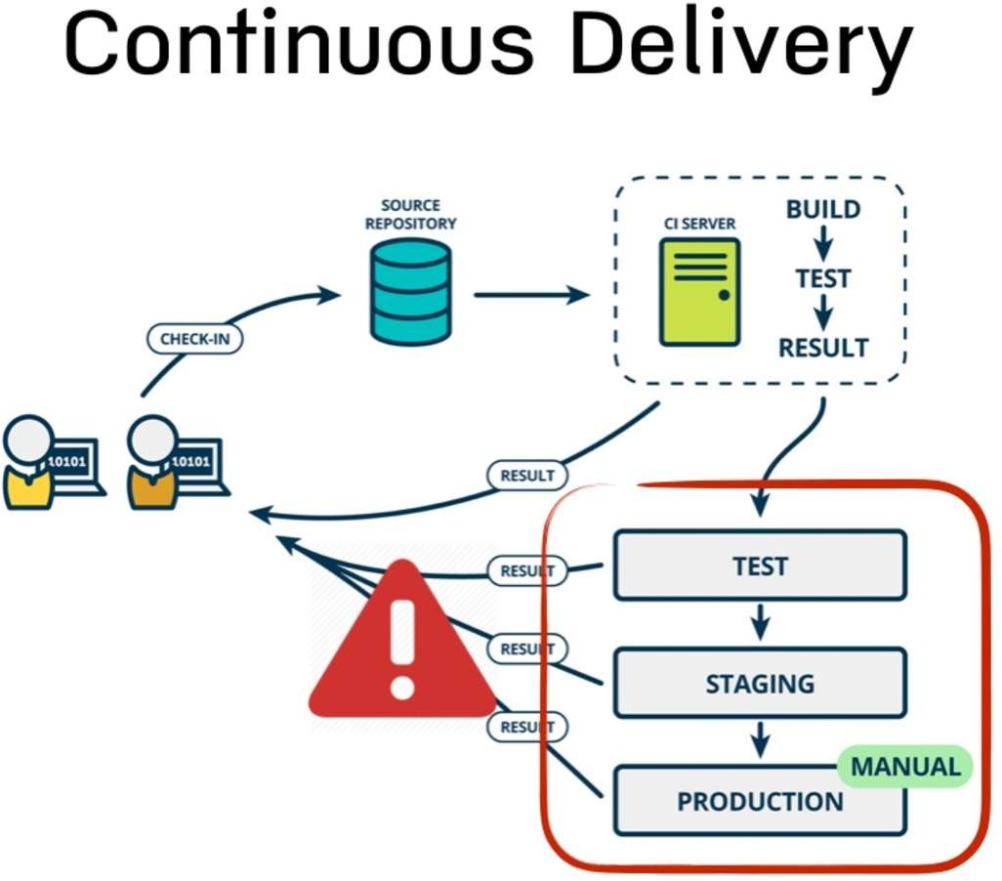
Sujata Batra

Slide 37
Sujata Batra

Slide 38
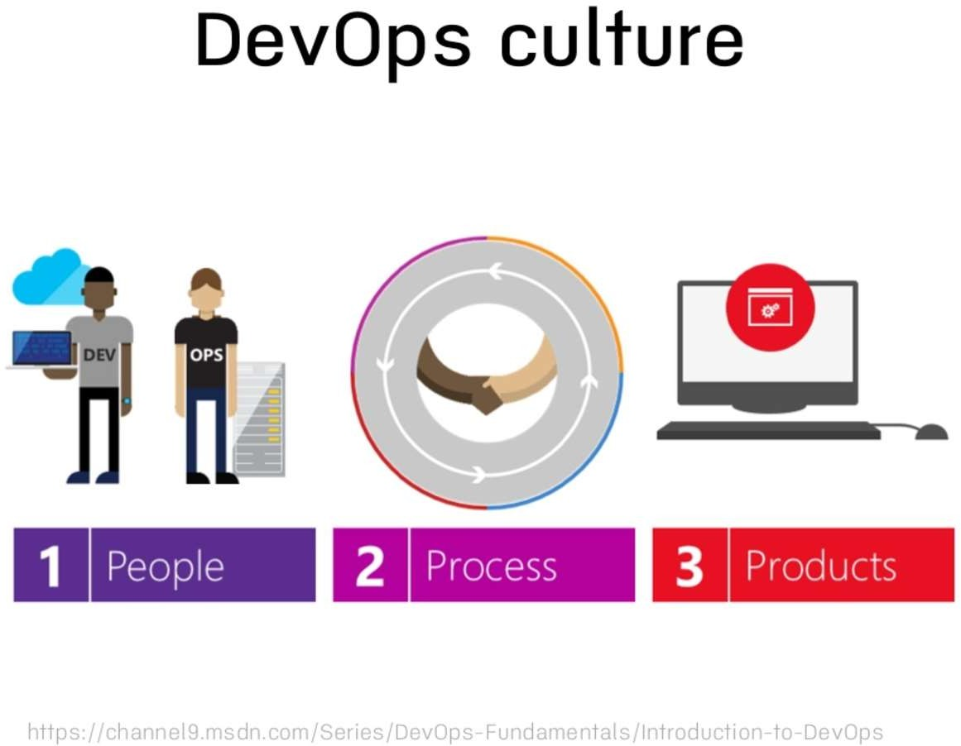
Sujata Batra

Slide 39
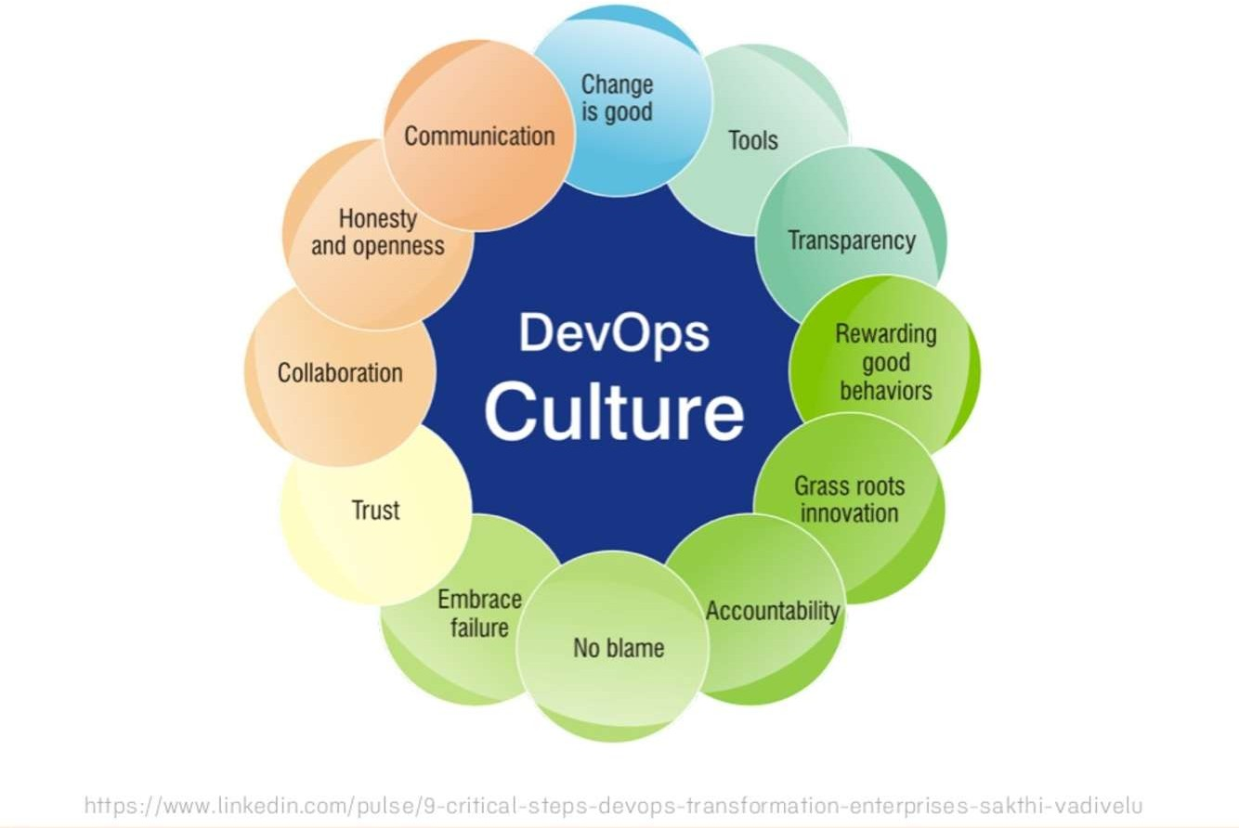
Sujata Batra

Slide 40

Tonight…
Sujata Batra

Slide 41
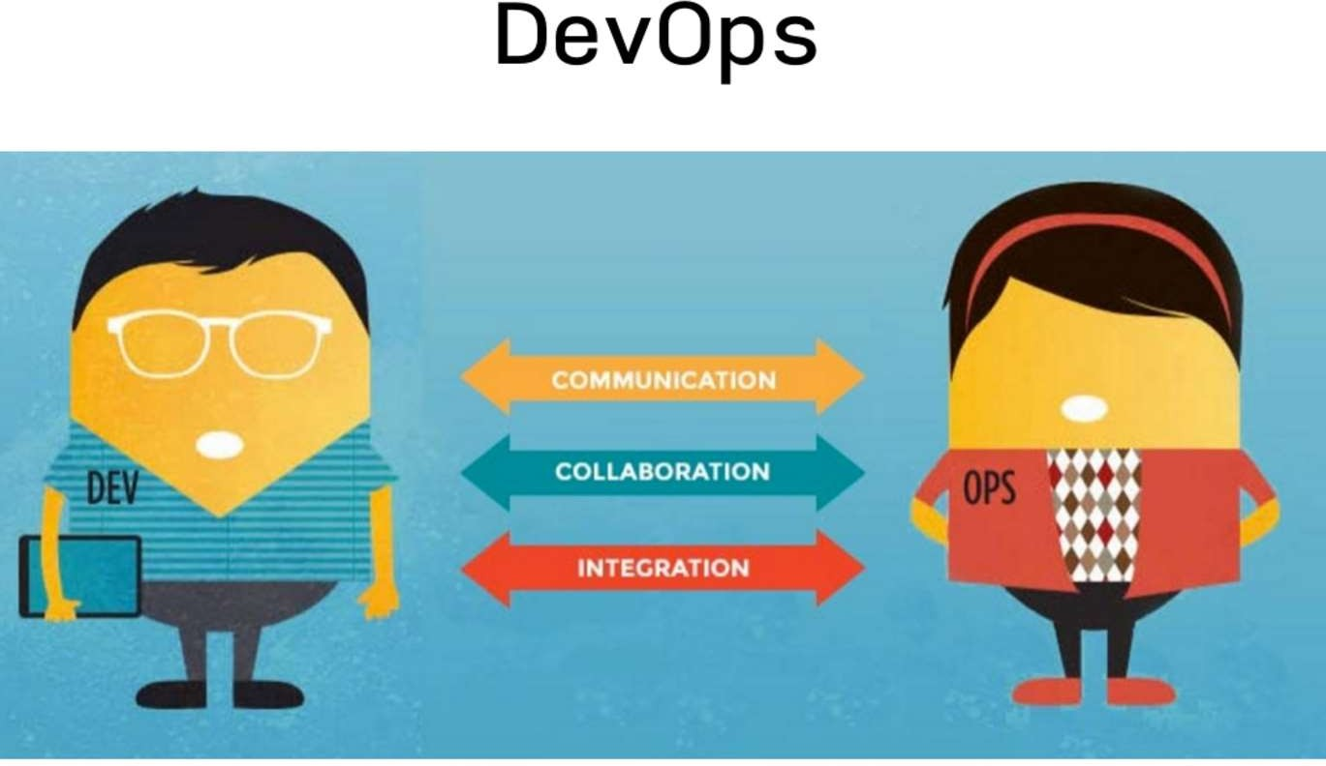
Sujata Batra

Slide 42
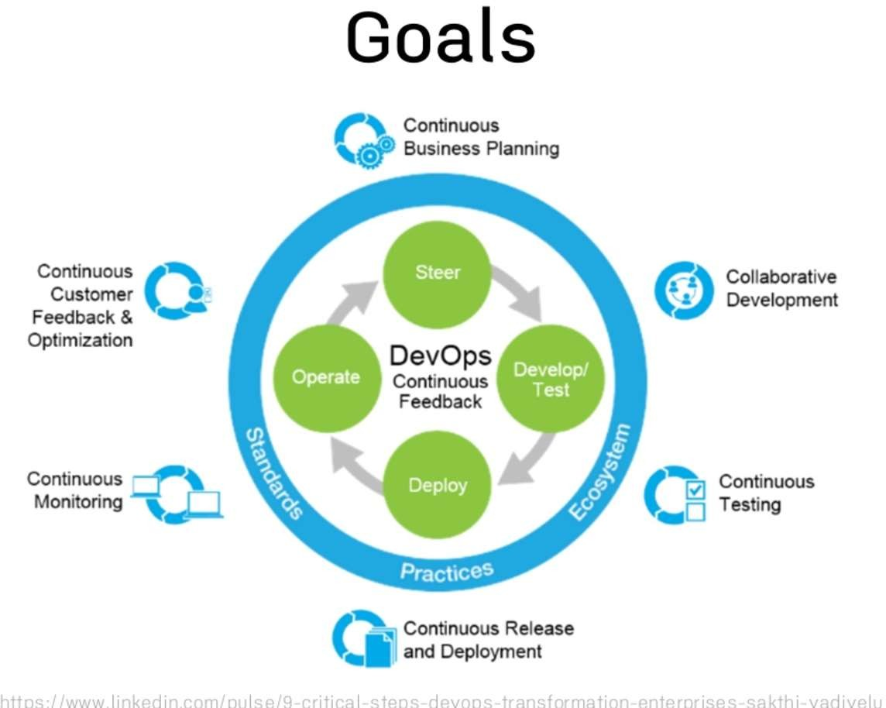
Sujata Batra

Slide 43
Add Ops into Dev
Sujata Batra
Enhance Service Design with Operation al Knowledge
Reliability
Performance
Security
Test Them
Build Feedback Loops from Production
Monitoring and KPI Dashboards
Postmortems
Foster Culture of Responsibility
Whether your code passes test, gets deployed and stays up for users us your responsibility
Make Development Better with Ops
Productionlike enviromnents
Power tooling

Slide 44
Accelerate Flow to Production
Sujata Batra
Reduce batch size
Automated environments means identical dev/test/prod
Create safety through automation
Continuous Integration/Testing
Automated Regression Testing
Continuous Delivery
Continuous Deployment
Feature Flags (A/B Testing)
Security Testing

Slide 45
Add Dev into Ops
Sujata Batra
Don’t do tasks for people
– Build tools so they can do their own work
Monitoring/logging/metrics feeds back into dev (and the business)
Blameless incident postmortems
Developers Do production support/empower ops acceptance

Slide 46
Sujata Batra

Slide 47
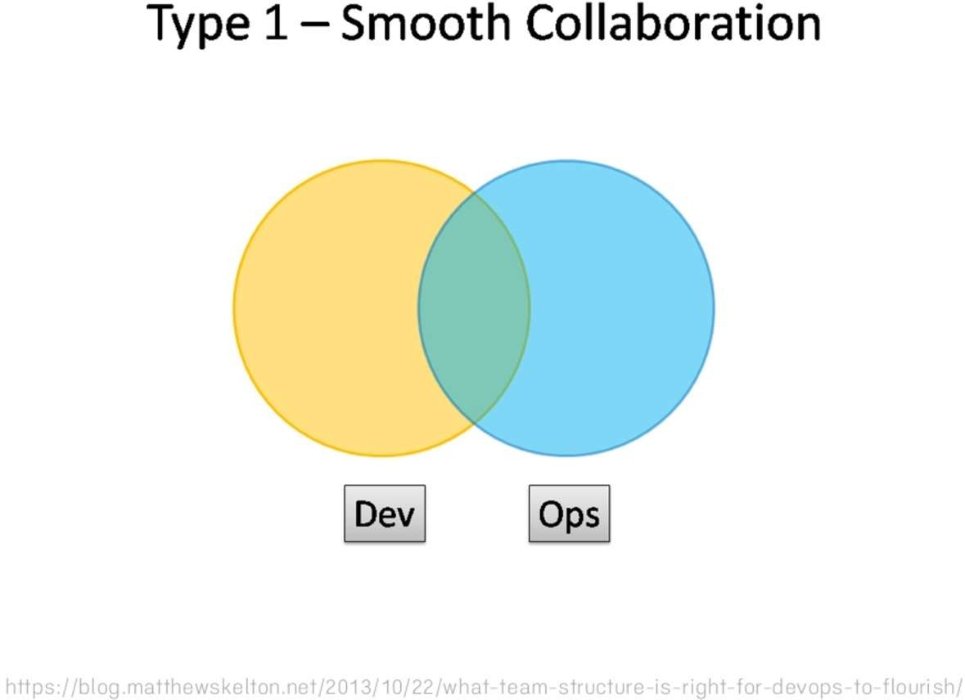
Sujata Batra

Slide 48
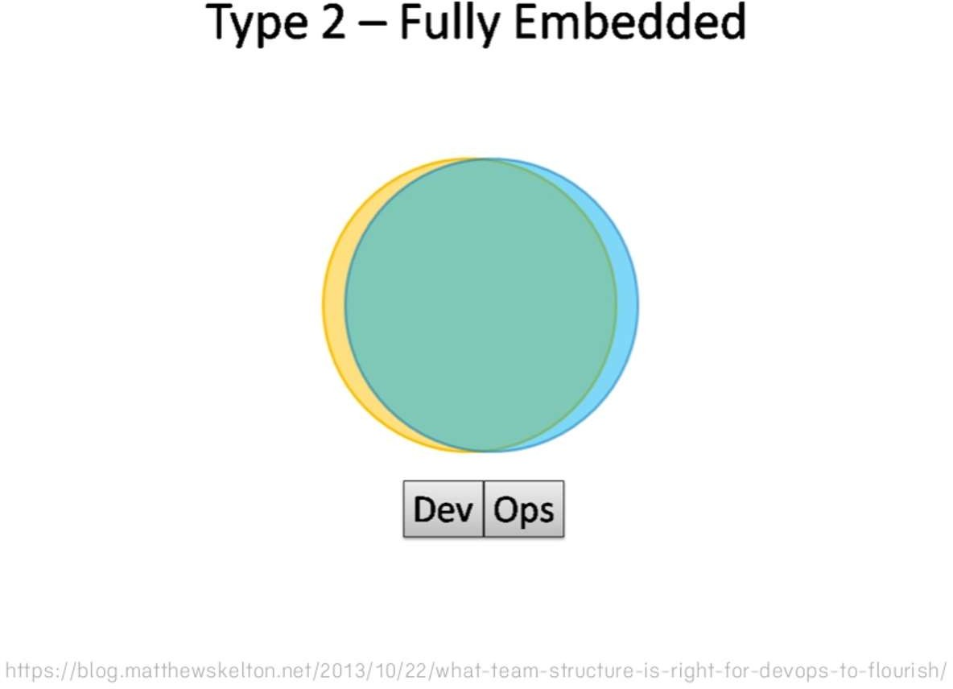
Sujata Batra

Slide 49
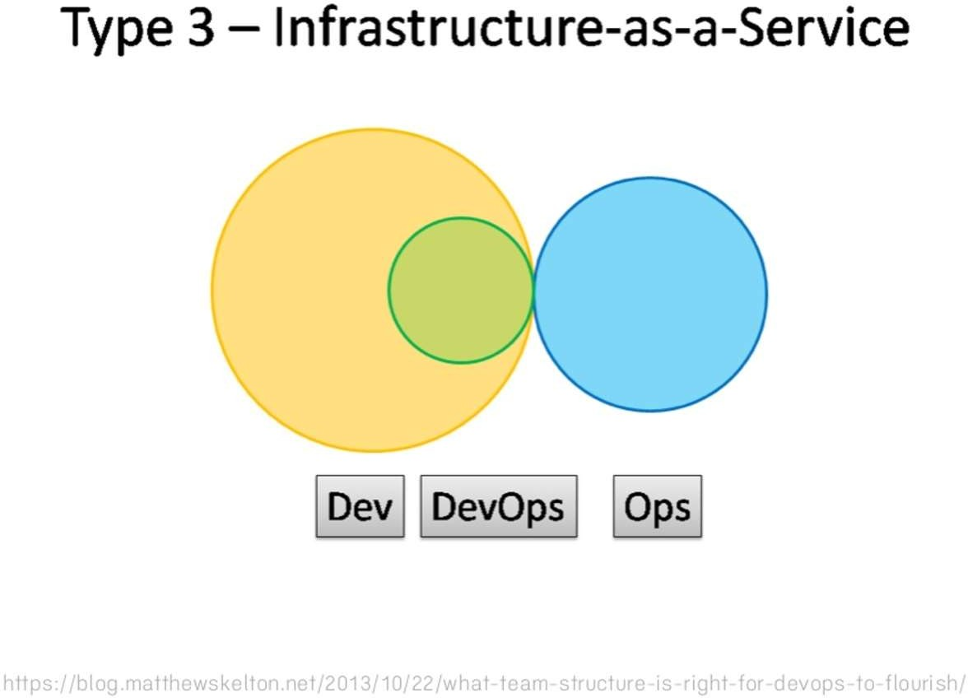
Sujata Batra

Slide 50
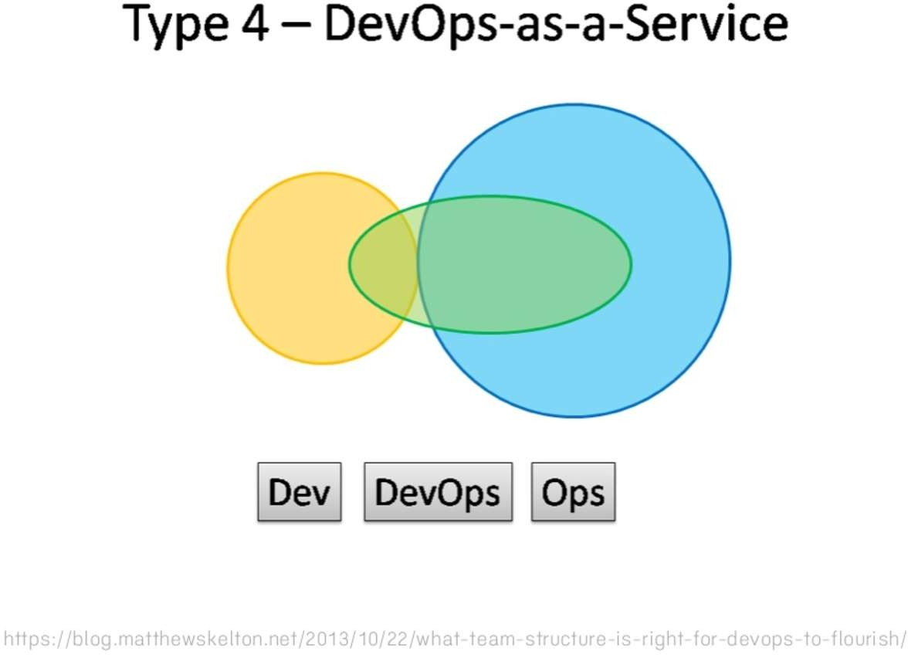
Sujata Batra

Slide 51
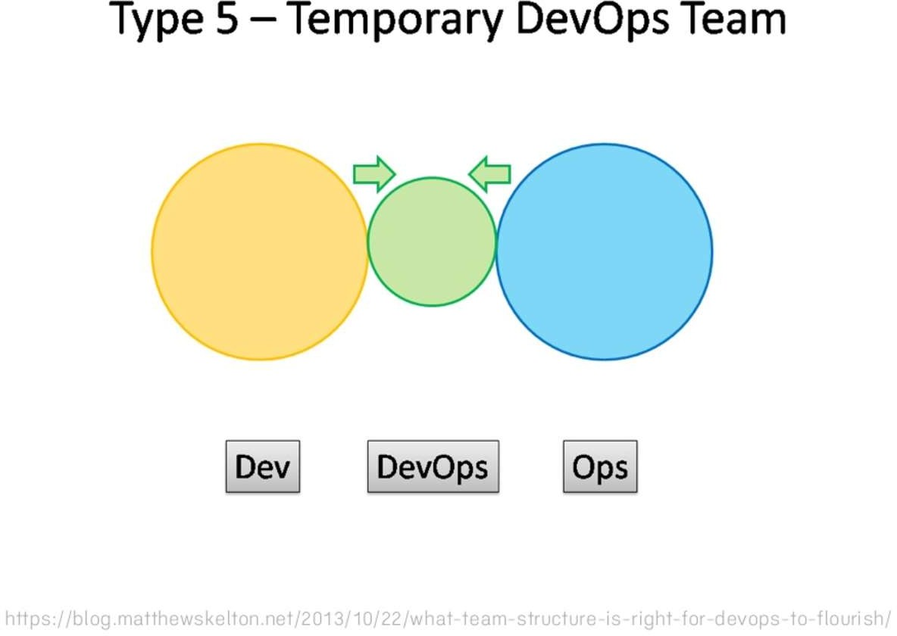
Sujata Batra

Slide 52
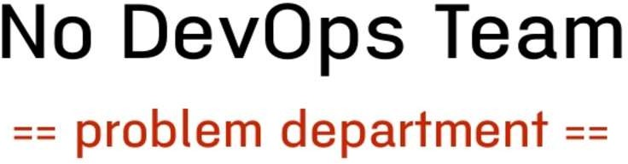
Sujata Batra

Slide 53

Sujata Batra

Slide 54
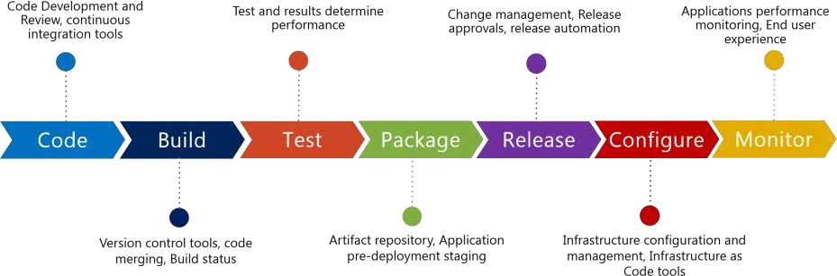
DevOps Toolchain
Sujata Batra

Slide 55
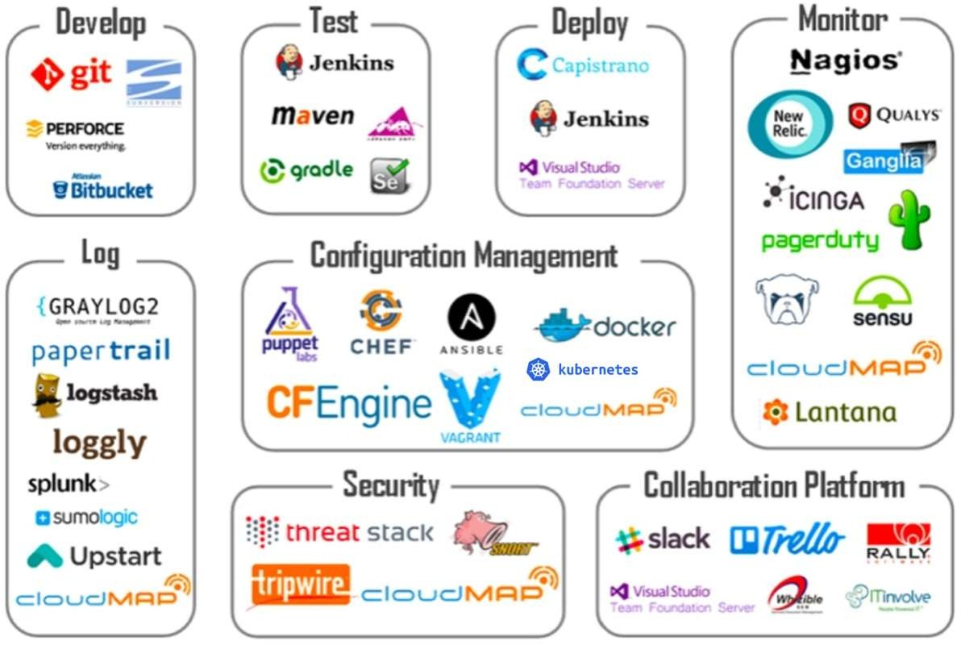
Sujata Batra

Slide 56
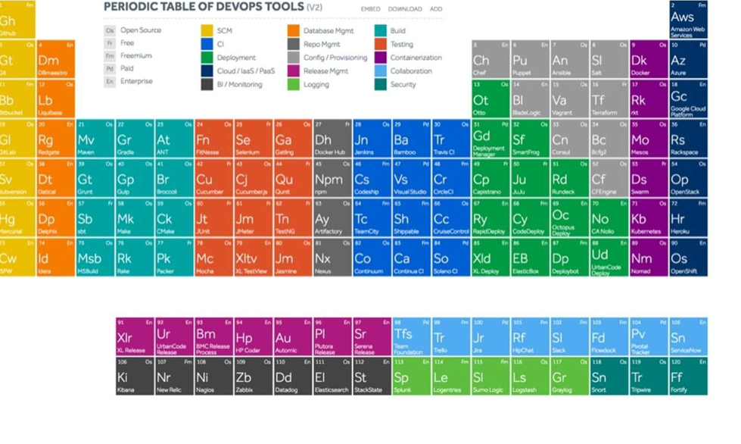

Slide 57
DevOps Trends
Sujata Batra

Slide 58
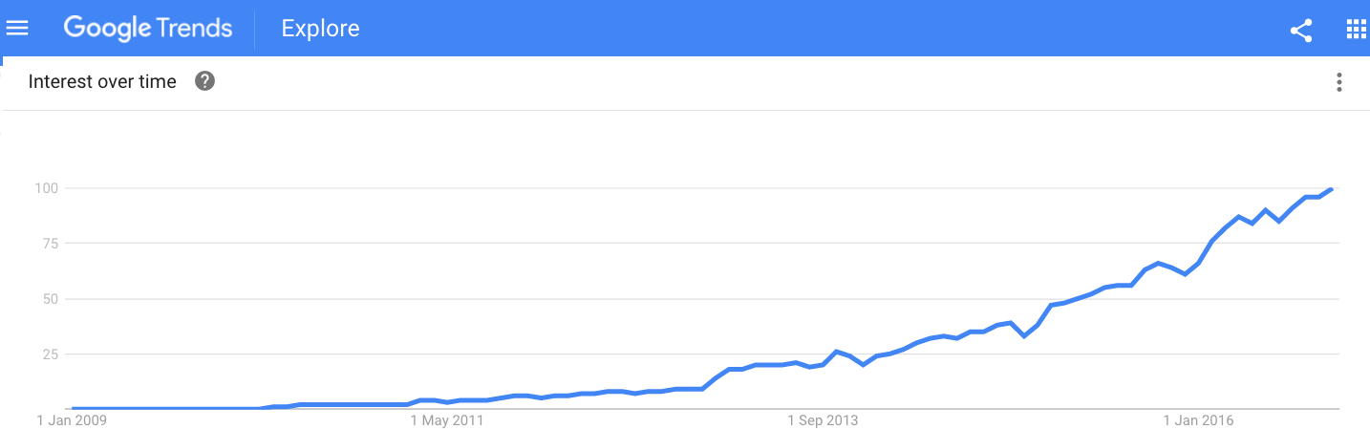


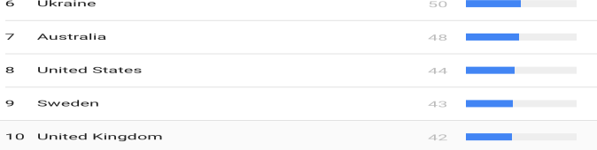
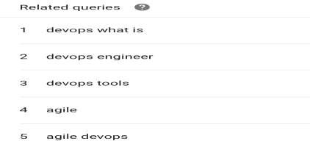

Slide 59
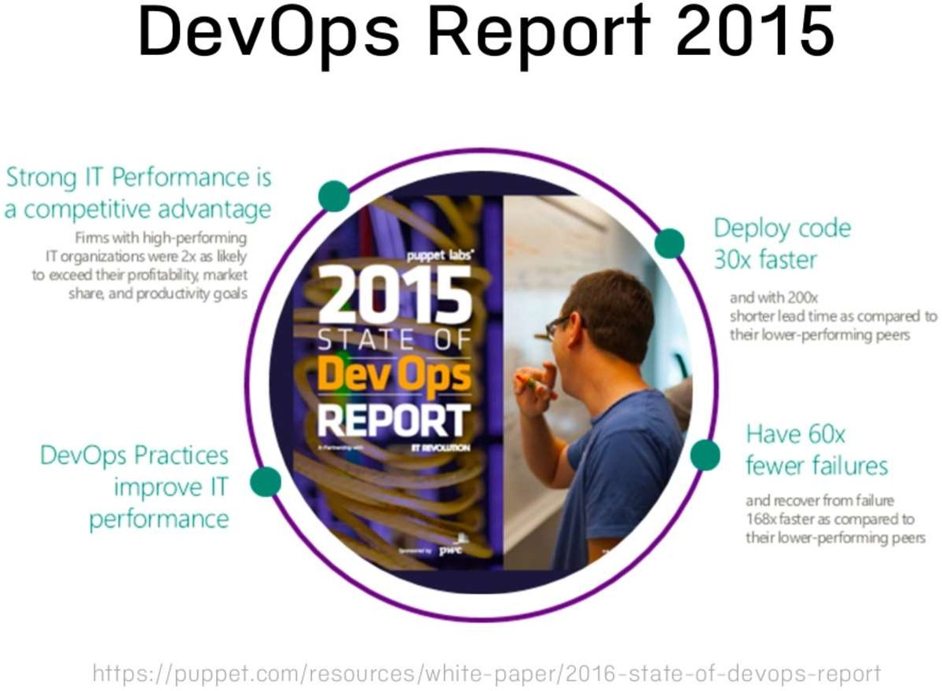
Sujata Batra

Slide 60
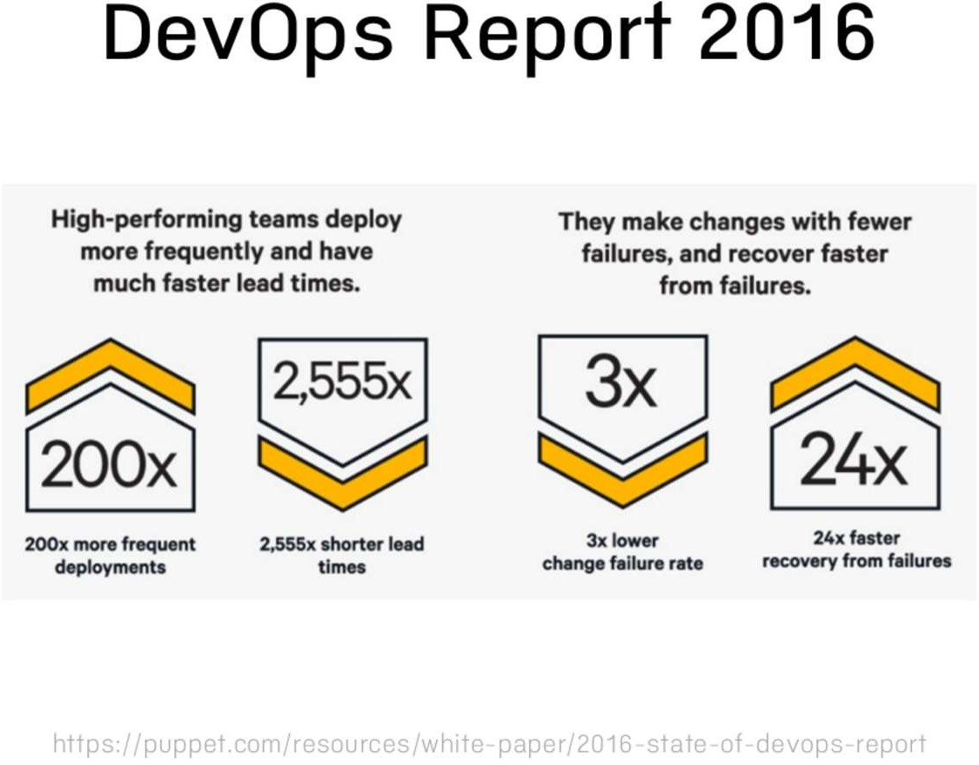
Sujata Batra

Slide 61

Sujata Batra

Slide 62
Sujata Batra

Slide 63
Sujata Batra

Slide 64
DevOps Toolchain
Sujata Batra

Slide 65
Sujata Batra

Slide 66
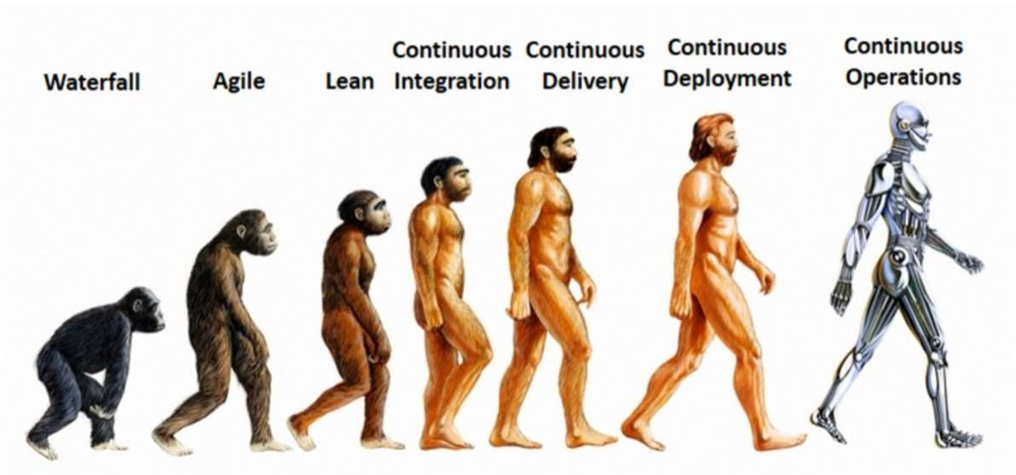
Sujata Batra

Slide 67
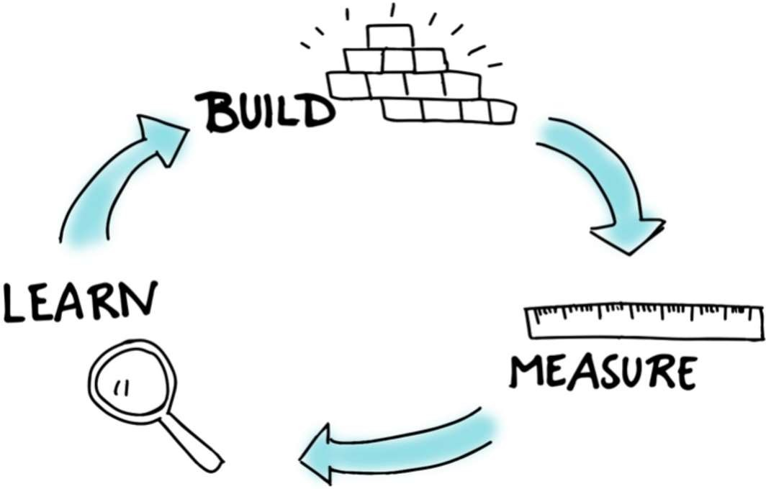
Sujata Batra

Slide 68
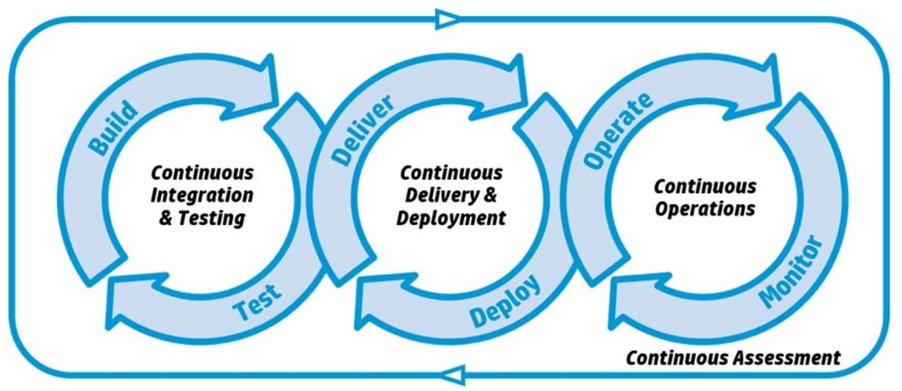
Sujata Batra

Slide 69

Sujata Batra

Slide 70
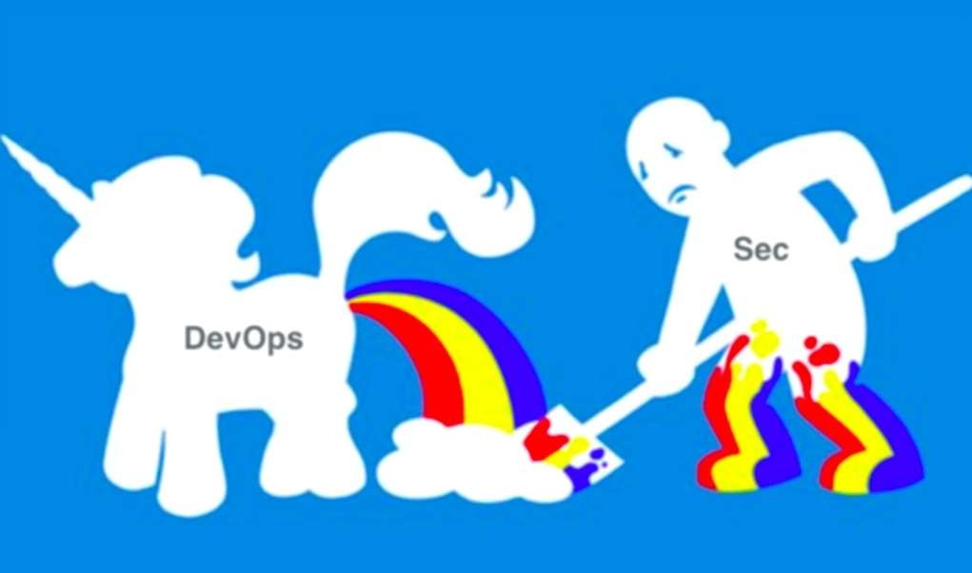
Sujata Batra

Slide 71
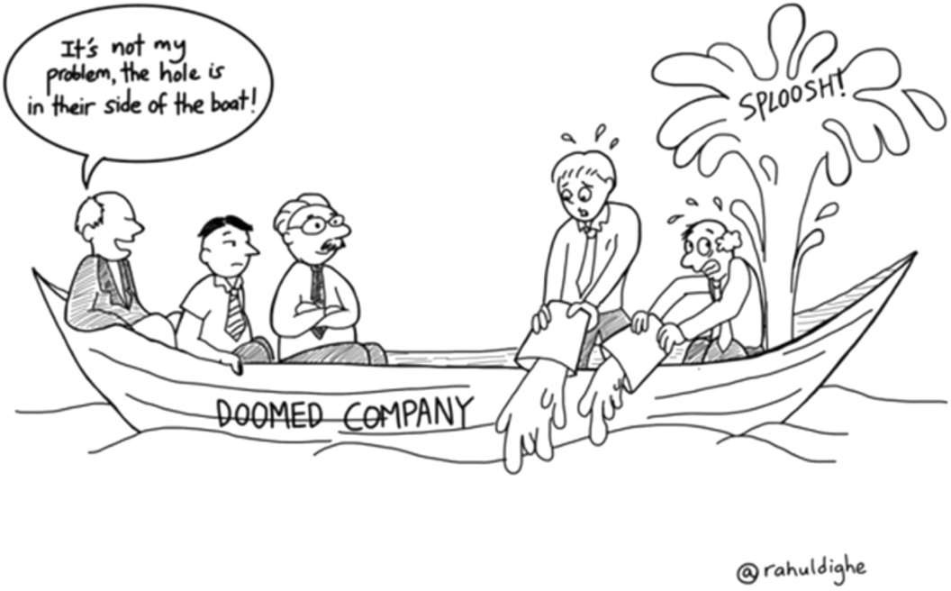
Questions?
Sujata Batra

